Slide 1

Lecture 17
Fundamentals and Applications (CSO201A)
Dr. Srinivas Dharavath
Assistant Professor
Department of Chemistry
Indian Institute of Technology, Kanpur
Kanpur- 208016
E-mail: srinivasd@iitk.ac.in

Slide 2
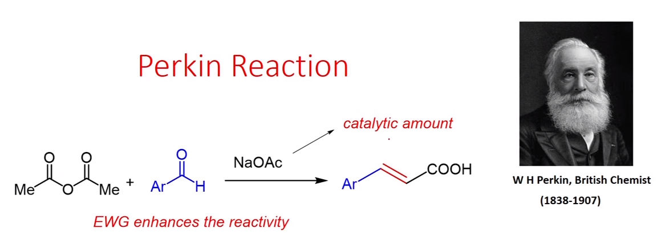
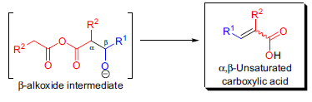
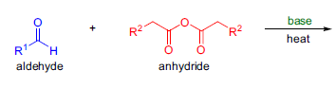

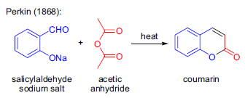
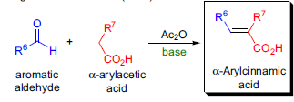
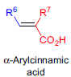


Perkin Reaction
The condensation of aromatic aldehydes with the anhydrides of aliphatic carboxylic acids in the presence of a weak base to afford α,β-unsaturated carboxylic acids is known as the Perkin reaction (or Perkin condensation).

Slide 3
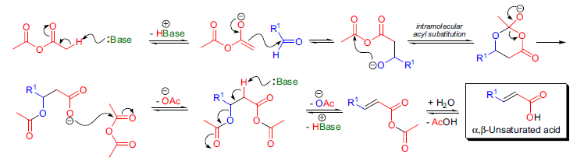

Mechanism

Slide 4
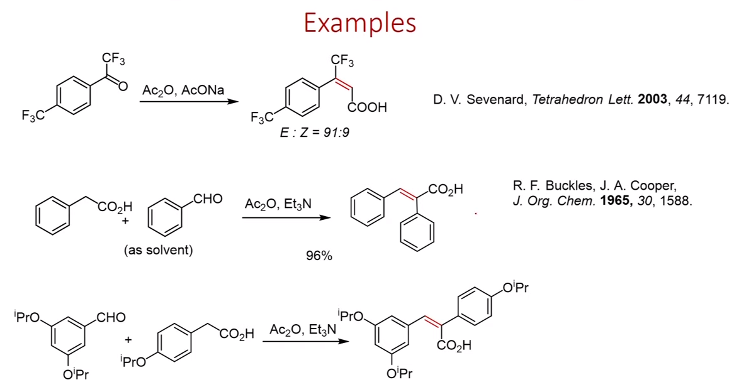
Examples

Slide 5
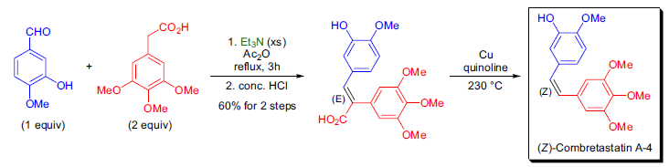
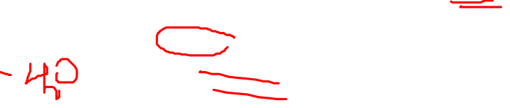
The combretastatins are a group of antimitotic agents isolated from the bark of the South African tree Combretum caffrum. A novel and highly stereoselective total synthesis of both the cis and trans isomers of combretastatin A-4 was developed by J.A. Hadfield and co-workers. The (Z)-stereoisomer was prepared using the Perkin reaction as the key step in which 3,4,5-trimethoxyphenylacetic acid and 3-hydroxy-4-methoxbenzaldehyde was heated with triethylamine and acetic anhydride at reflux for several hours. The α,β-unsaturated acid was isolated in good yield after acidification and had the expected (E) stereochemistry. Decarboxylation of this acid was effected by heating it with copper powder in quinoline to afford the natural product (Z)-combretastatin A-4.

Slide 6
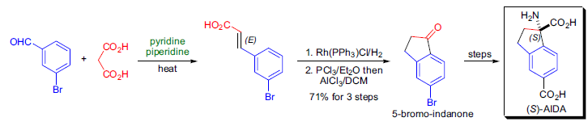
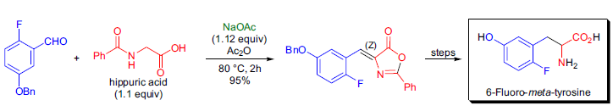
In the laboratory of D. Ma, the asymmetric synthesis of several metabotropic glutamate receptor antagonists derived from α-alkylated phenylglycines was undertaken. The preparation of (S)-1-aminoindan-1,5-dicarboxylic acid (AIDA) started with the Perkin reaction of 3-bromobenzaldehyde and malonic acid. The resulting (E)-cinnamic acid derivative was hydrogenated and the following intramolecular Friedel-Crafts acylation afforded the corresponding indanone, which was then converted to (S)-AIDA.
Fluorinated analogs of naturally occurring biologically active compounds, such as amino acids, often exhibit unique physiological properties, and therefore there is substantial interest in their convenient and high-yielding preparation. The research team of K.L. Kirk synthesized 6-fluoro-meta-tyrosine and several of its metabolites employing the Erlenmeyer-Plöchl azlactone synthesis. Hippuric acid and 2-benzyloxy-5-fluorobenzaldehyde were condensed in the presence of sodium acetate in acetic anhydride to isolate the corresponding azlactone, which was converted to the target fluorinated amino acid in three steps.

Slide 7
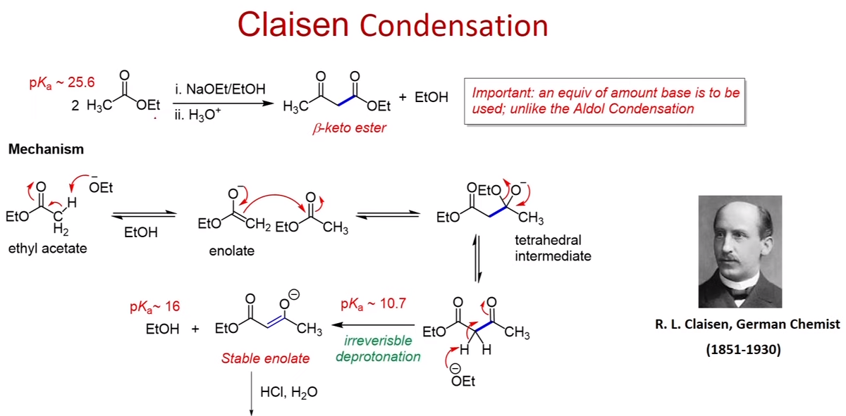
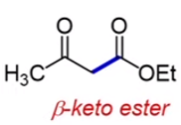
Claisen Condensation

Slide 8
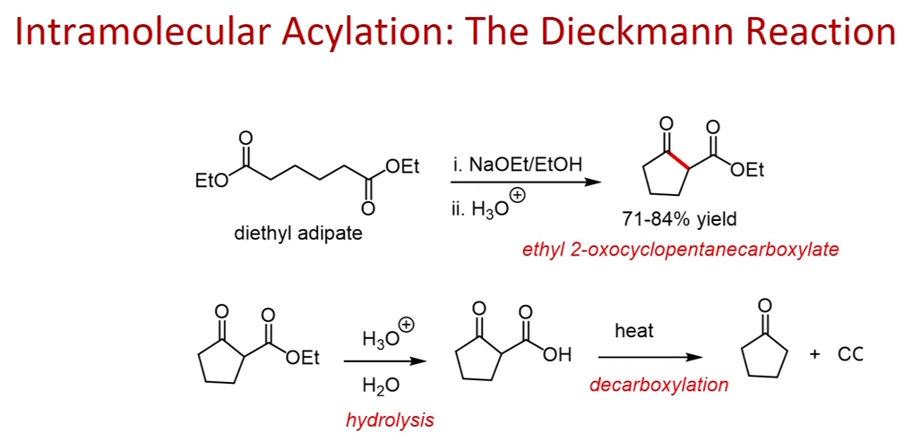
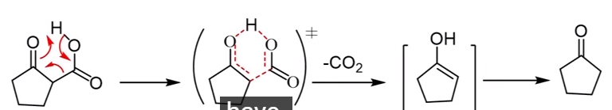
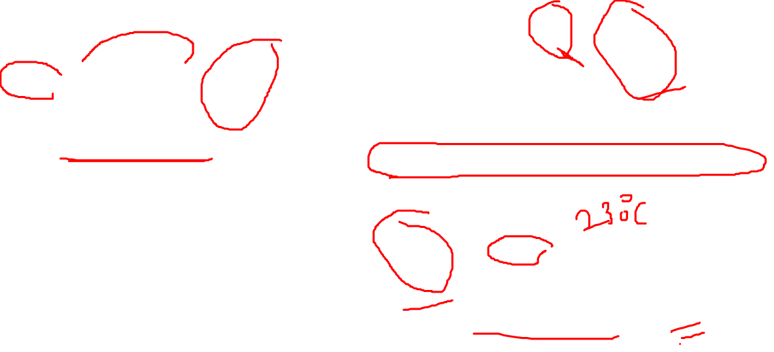
Intramolecular Acylation:The Dieckmann Reaction

Slide 9
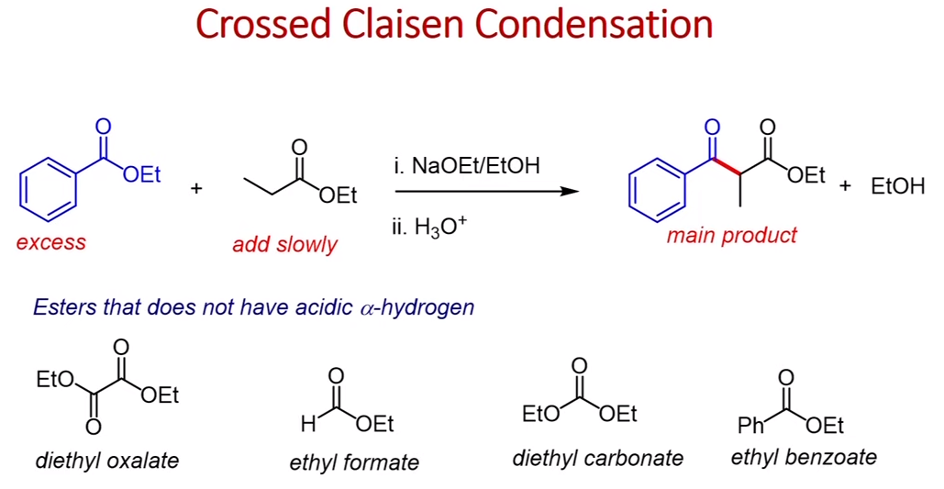

Crossed Claisen Condensation

Slide 10
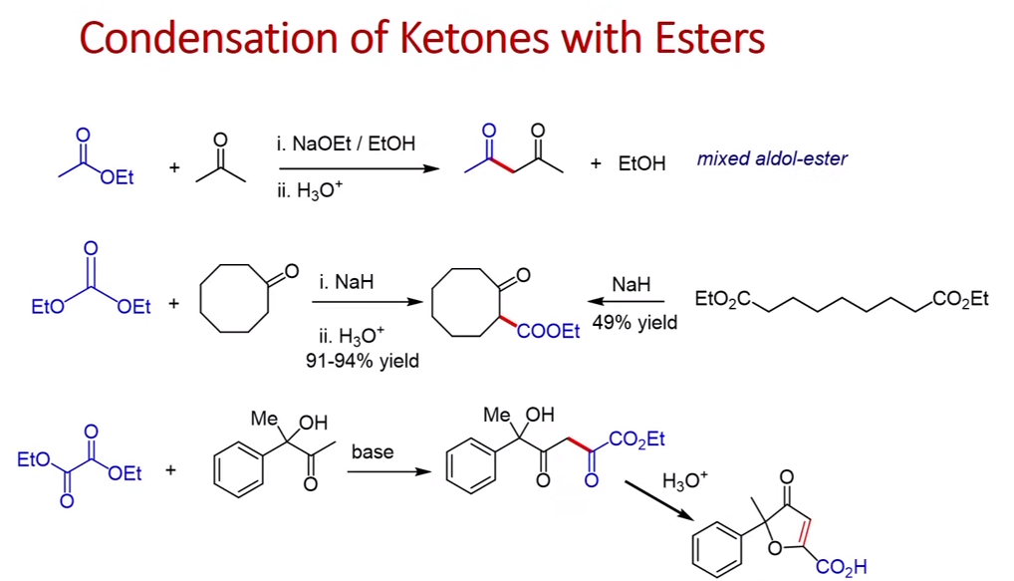
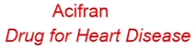

Condensation of ketones with Esters

Slide 11
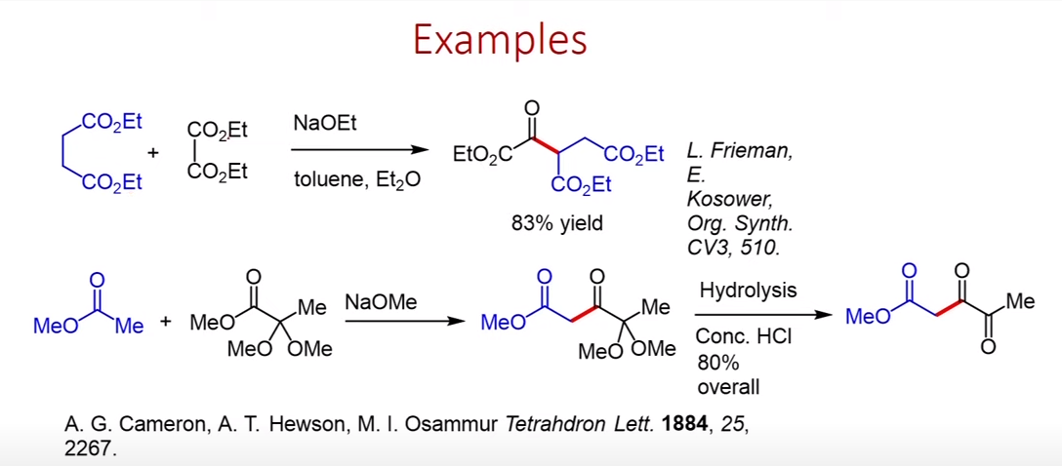

Examples

Slide 12
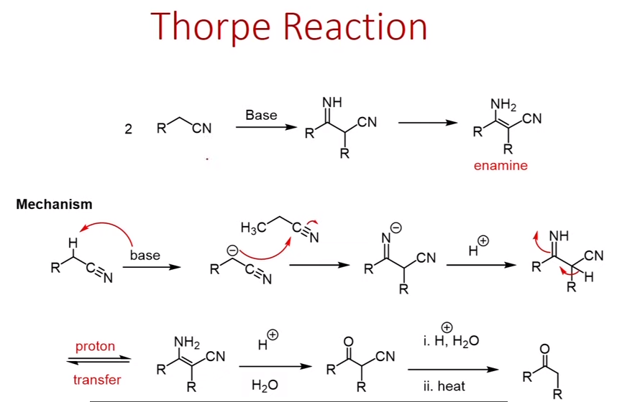
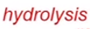
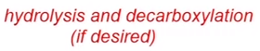

Thorpe Reaction

Slide 13
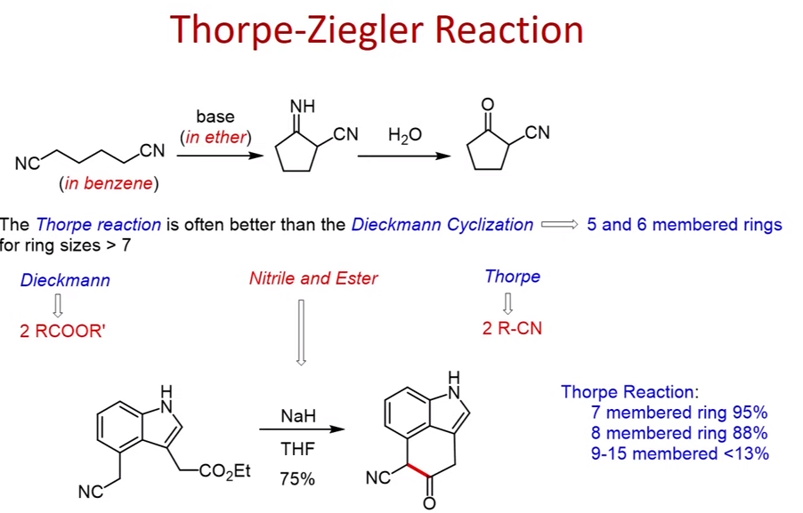

Thorpe Ziegler Reaction

Slide 14
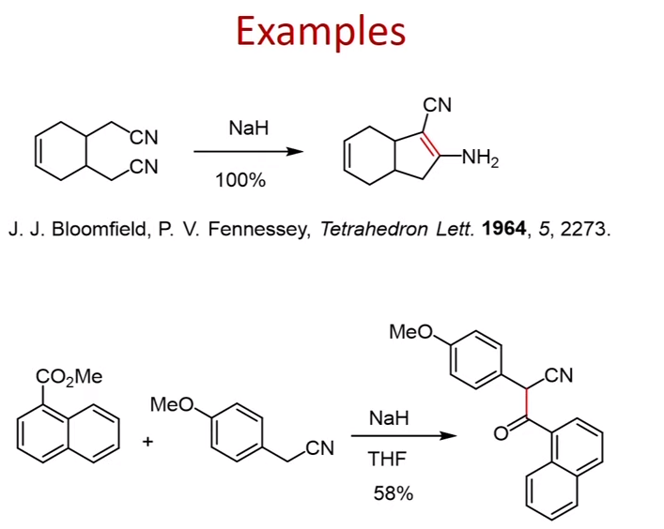
Examples

Slide 15
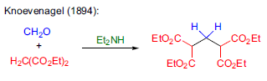
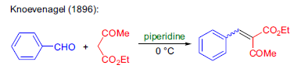
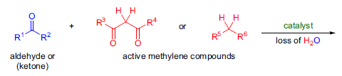
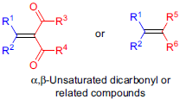
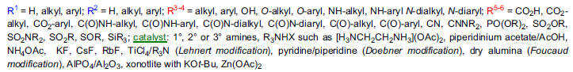

Knoevenagel condensation
The reaction of aldehydes and ketones with active methylene compounds in the presence of a weak base to afford α,β-unsaturated dicarbonyl or related compounds is known as the Knoevenagel condensation.

Slide 16
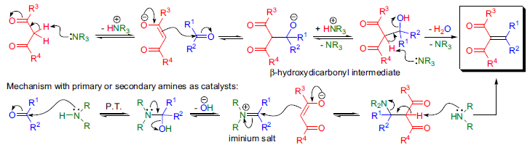
Knoevenagel condensation
The Knoevenagel condensation is a base-catalyzed aldol-type reaction, and the exact mechanism depends on the substrates and the type of catalyst used. The first proposal for the mechanism was set forth by A.C.O. Hann and A. Lapworth (Hann-Lapworth mechanism) in 1904. When tertiary amines are used as catalysts, the formation of a β- hydroxydicarbonyl intermediate is expected, which undergoes dehydration to afford the product. On the other hand, when secondary or primary amines are used as catalyst, the aldehyde and the amine condense to form an iminium salt that then reacts with the enolate. Finally, a 1,2-elimination gives rise to the desired α,β-unsaturated dicarbonyl or related compounds. The final product may undergo a Michael addition with the excess enolate to give a bis adduct.

Slide 17
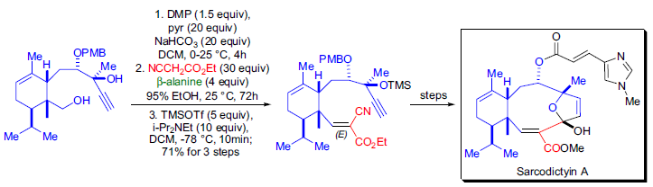
Examples
The total synthesis of the marine-derived diterpenoid sarcodictyin A was accomplished in the laboratory of K.C. Nicolaou. The most challenging part of the synthesis was the construction of the tricyclic core, which contains a 10- membered ring. This macrocycle was obtained by the intramolecular 1,2-addition of an acetylide anion to an α,β- unsaturated aldehyde. This unsaturated aldehyde moiety was installed by utilizing the Knoevenagel condensation catalyzed by β-alanine. The Knoevenagel product was exclusively the (E)-cyanoester.

Slide 18
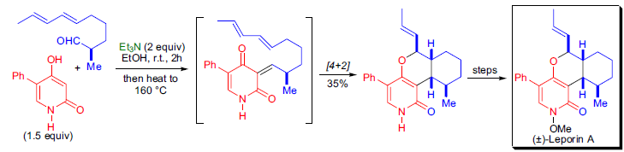
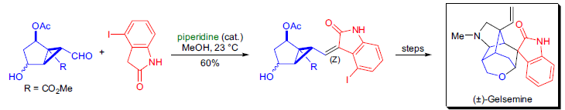
Examples
During the total synthesis of (±)-leporin A, a tandem Knoevenagel condensation/inverse electron demand intramolecular hetero-Diels-Alder reaction was employed by B.B. Snider et al. to construct the key tricyclic intermediate. The condensation of pyridone with the enantiopure acyclic aldehyde in the presence of triethylamine as catalyst afforded an intermediate that underwent a [4+2] cycloaddition to afford the tricyclic core of the target.
The stereocontrolled total synthesis of (±)-gelsemine was accomplished by T. Fukuyama and co-workers using the Knoevenagel condensation to prepare a precursor for the key divinylcyclopropane-cycloheptadiene rearrangement. The use of 4 iodooxindole as the active methylene component allowed the preparation of the (Z)-alkylidene indolinone product as a single stereoisomer.

